Slide 1
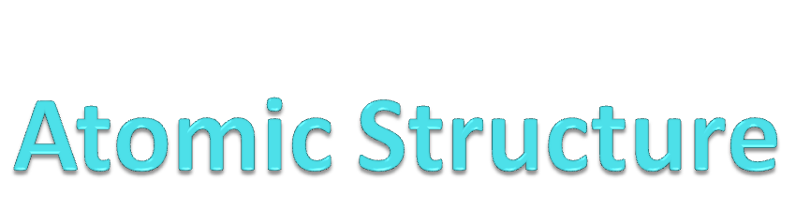
Chapter 4

Slide 2
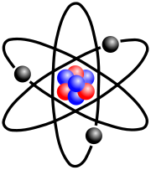
Section 2
The Structure of an Atom

Slide 3
Modern Atomic Models
Over recorded human history there has been a number of contributing scientists and their experiments that have lead us to the more modern, acceptable model of the stuff that makes up the universe.
Although incorrect, the Greek philosophers, Dalton, Thompson, and Rutherford all helped shape our modern theories on the atom.

Slide 4
Atomic Structure
What we’ve seen so far…
Dalton proved Democritus correct that matter was made of atoms using the consistent ratio of masses that combined during chemical reactions as evidence.
Thompson theorized that atoms have equal positive and negative charges after discovering electrons in his deflected Cathode Ray experiment.
Rutherford proved that there is a nucleus composed of positive charges in his gold foil experiment.
What were their individual models?
  Dalton: Wooden Spheres
  Thompson: Plum Pudding
  Rutherford: Nucleus & Electron Cloud
We’ll develop this further and spend the next few days learning how atoms are constructed and how each element is different from the others.

Slide 5
Atomic Structure
Objectives:
Part 1
Identify the three subatomic particles that make up an atom.
List the properties that can be used to compare protons, electrons, and neutrons.
Part 2
List features that make atoms of one element different from another.
Define what an isotope is and identify what makes isotope of the same element different.

Slide 6
Vocabulary
Proton
Electron
Neutron
Atomic Number
Mass Number
Isotopes

Slide 7
Atoms
Every living and nonliving thing is made of matter.
Matter is anything that has mass and takes up space.
All matter is made of very small particles called atoms.
An atom is the smallest unit of matter that cannot be broken down by chemical means.
  This means that there are smaller parts, but these smaller parts are not true matter.

Slide 8
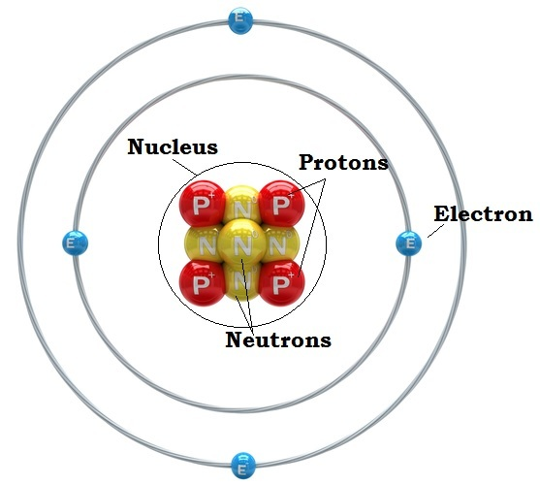
Atoms: Subatomic Particles
The atom is composed of three main types of smaller “subatomic” particles.
(p+) Protons: positively charged particles.
(n°) Neutrons: particles with no charge.
(e-) Electrons: negatively charged particles.

Slide 9
Atomic Structure
Electron Cloud:
Electrons orbit the nucleus in a cloud in orbitals.
The subatomic particles are found in two distinct regions:
The Nucleus: contains 99.9% of the mass and 100% of the positive charge.
Protons and Neutrons are here
The Electron Cloud: (Aka orbitals) 99.9% of the volume & 100% of the negative charge.
Electrons are here.
Nucleus:
Where the protons and neutrons are.

Slide 10
The Atom: The particles are dynamic.
-
Negatively charged electrons in the orbits are constantly moving.
-
Positive protons & neutral neutrons are motionless contained in the nucleus.
-
-
-
+
+
+
+
+
+
-
-
-
-
-

Slide 11
Atomic Structure
Together all the protons, neutrons and electrons make up an atom.
Each of these particles are slightly different though and are distinguishable by three main properties:
  MASS,
  CHARGE,
  and LOCATION (Volume, in essence).
We’ll sort these out by filling in a chart in your notebooks.

Slide 12
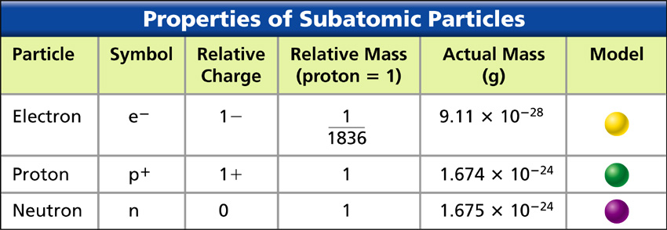
Atomic Structure: Particle Mass
Protons and neutrons have pretty much the same mass.
Electrons are roughly 2000th the mass of protons.
1/2000

Slide 13
Not completely different from their masses, the size of an electron is 1000th the diameter of protons & electrons.
Electron = 10⁻¹⁸m
Proton = 10⁻¹⁵m
+1 charge
-1
Neutron = 10⁻¹⁵m
0 charge

Slide 14
Atomic Structure: Charge
The subatomic particles have different charges associated with them, giving them different properties. The charges of these particles are very important to remember.
They really give the atom much of its characteristics.
Each proton is worth +1
Each electron is worth -1
Neutrons are worth 0 charge.
Most atoms in nature are neutral, meaning they have no overall charge.
This means that proton # and electron number are generally the same.

Slide 15
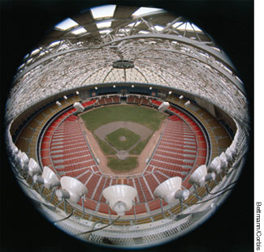

Quick Facts. Put an atom into perspective.
If you used a stadium to model and atom…
  The Houston Astrodome (Home of the Houston Astros…a baseball team) seats 60,000 fans, covers 9 acres and the dome rises to a height of 200ft.
  If you could blow up an atom to the size of this stadium a basketball could represent the volume of an atom's nucleus.
  The rest of the open area is the volume of where the electrons, maybe the size of tiny BB’s, would be constantly flying around at speeds approaching the speed of light through the electron cloud in their orbitals.
+
+
+
+
+
+

Slide 16

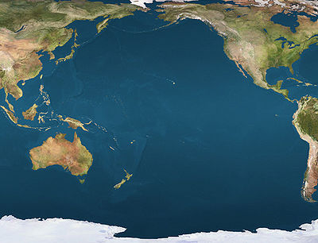
Put this into perspective…
99.9% of the space you occupy is EMPTY SPACE occupied by electrons.
99.9% of your mass is contained in less than 0.1% of your volume.
If we were to be able to suck all the volume from your body (removed the electron cloud) you would shrink into the size smaller that a grain of sand but you would weigh the same.
There are 7+ billion people on Earth. If we sucked all the volume from everyone and put just the leftover nuclei together the entire human species could fit into the volume of an apple.
@ 68kgs (150lbs) the apple would have the mass of over a trillion lbs.
That’s roughly the mass of the entire Pacific Ocean in the size of and apple.

Slide 17
Summarize the subatomic particles in the chart…
Particle | Symbol | Relative Charge | Relative Mass | Location
Electron
Proton
Neutron

Slide 18
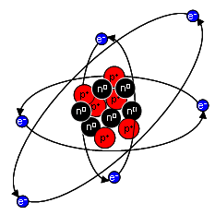
Atomic Structure: Location
Remember that an atom is made up of two regions:
  The nucleus &
  The orbits
Protons & Neutrons are in the nucleus.
Electrons are in the orbits.

Slide 19
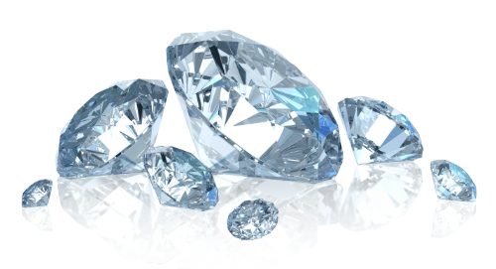
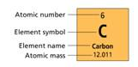
What is an Element?
Find carbon on the periodic table.
This is the information for the element CARBON
Notice its row and column.
Every box represents a different element.
  An element is any quantity of a substance that is 100% the same type of atom.
  Being the same type means they have the same # of protons.
  Ex: Diamonds are always the element carbon, regardless of the size, because every atom in a diamond is carbon and carbon has 6 protons.

Slide 20
Atomic Structure. Intro to the Periodic Table
Let’s start with designations.
Atoms need to be categorized somehow so we can differentiate one element from another.
How is it done?

Slide 21
Atomic Structure. Intro to the Periodic Table
Scientists us the Atomic Number to do this.
It has been determined that all atoms of the same element have one thing in common…the number of protons.
& Every different element has a different number of protons.
  All carbon atoms have 6 protons, all hydrogen atoms have 1.
So, the Atomic Number of an element = the number of protons in a particular atomic nucleus.

Slide 22
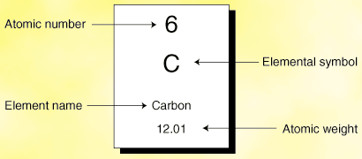
= # of PROTONS

Slide 23
Atomic Structure
Mass Number
What do you know about the mass of a proton and a mass of a neutron?
The mass of the neutron and proton are almost exactly the same.
Remember, together the mass of the proton and neutron makes up about 99.9% of the mass of an element.
If the # of protons and neutrons are added together you get the Mass Number (or Atomic Mass) of an element.
This feature is again, unique for each element.

Slide 24
Periodic Table Key
= # of PROTONS…
Mass Number
Aka Atomic mass
Aka
= # protons + # neutrons
SO… #neutrons = Atomic Mass - +protons
(Atomic Number)

Slide 25
Atomic Structure
Proton and neutron numbers are not always equal…
Sometimes they are equal:
  Oxygen has both 8 protons and 8 neutrons
  The atomic mass is near 16
But sometimes they are not:
  Polonium has 84 protons but 125 neutrons.
  The atomic mass is near 209.
Why isn’t important now, but it becomes more important the higher you get in chemistry.
It has to do with strong and weak nuclear forces…an interesting force that holds protons and neutrons together.

Slide 26
Atomic Mass
Question then…
If the # protons doesn't always equal the number of neutrons, how would you ever know how many neutrons are present for an element?
  Hint…you always know the mass number and atomic number.
It’s really simple.
Subtract the Atomic Number from the Mass Number.

Slide 27
Calculating the # Neutrons
Find Potassium on your Period Table.
Where’s the Atomic Number?
Where’s the Mass Number?
You must first round the mass # to the nearest whole number.
19
K
Potassium
39.0983
Subtract the atomic number from the mass number and you always get the # of neutrons.
39 – 19 = 20 neutrons

Slide 28
Atomic Structure
Lets consider an atom of the element Oxygen.
Oxygen has 8 protons in its nucleus
Therefore its Atomic Number is 8
And its Atomic Mass is 16.
Then there are 8 neutrons in its nucleus.

Slide 29
Atomic Structure: Practice
The Structure of An Atom: Atomic Mass and Number
For each example below find the atomic mass and the atomic number:
  Potassium has 19 protons and 20 neutrons.
  Lithium has 3 protons and 3 neutrons
  Krypton has 36 protons and 47 neutrons
  Iodine has 53 protons and 73 neutrons
  Gold has 79 protons and 117 neutrons
19
3
36
126 53
196 79

Slide 30
Atomic Structure
The Structure of An Atom
Now that we know how to figure Atomic Number, Atomic Mass, and the # of neutrons, how do we know the number of electrons orbiting an atomic nucleus?
All atoms are Neutral in Electrical Charge: the number of negative (-) charges equals the number of positive (+) charges therefore:
# of protons = number of electrons

Slide 31
Periodic Table Key
= # of PROTONS…
(& ELECTRONS)
Mass Number
Aka Atomic mass
Aka
= # protons + # neutrons
SO… #neutrons = Atomic Mass - +protons
(Atomic Number)

Slide 32
Atomic Structure…
So lets go back and for each of the previous elements how many electrons are orbiting the nucleus?
  Potassium has 19 protons
  Lithium has 3 protons
  Krypton has 36 protons
  Iodine has 53 protons
  Gold has 79 protons
How many electrons does each have?
19
3
36
53
79

Slide 33
Atomic Structure: Isotopes
As you now know, the number of protons is used to distinguish between elements.
Why?
It is because atoms of an element always have the same number of protons.
Sometimes atoms of the same element have different numbers of neutrons though.
This results in slightly different mass numbers because they have different combinations of protons and neutrons in their nucleus.
Isotopes are then, atoms of the same element that have different numbers of neutrons, therefore different masses than their stable base atoms.

Slide 34
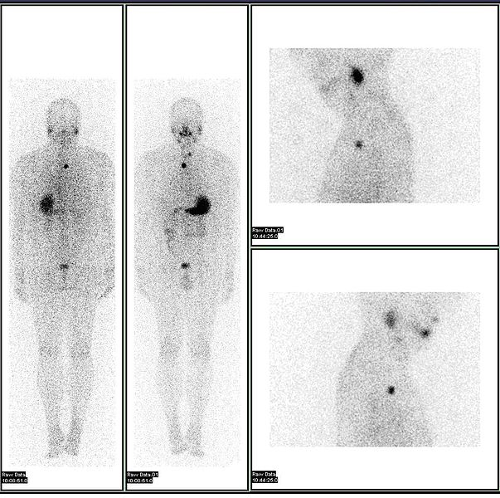
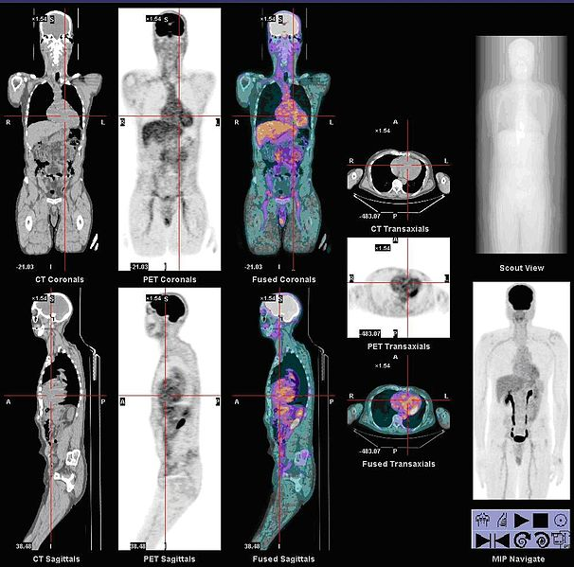
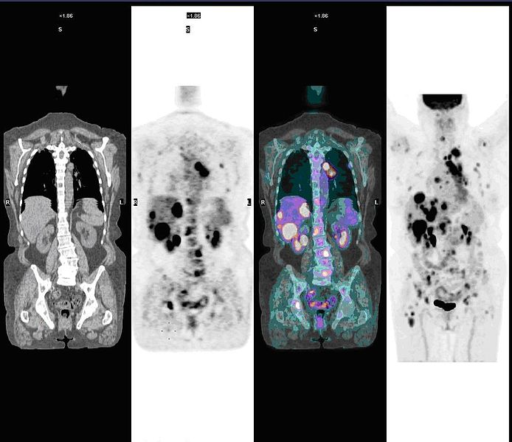
PET-CT Scan
Using a fluorine-18
isotope
PET-CT Scan
Using a iodine-123 isotope

